Slide 1
Lecture time: 4 to 6 PM
Lecture 1. Genetics (February 3)
Lecture 2: Molecular Genetics (February 5)
Lecture 3: Molecular Markers and Molecular Breeding (February 7)
Lecture 4: Transgenic Technology: Methods (February 10)
Lecture 5: Engineering Traits (February 12)
Lecture 6: Recent Advances in Plant Breeding (February 14 & 26)
Madan K. Bhattacharyya, Ph.D.
Professor, Iowa State University
Adjunct Prof., Assam Agricultural University
mbhattac@iastate.edu

Slide 2
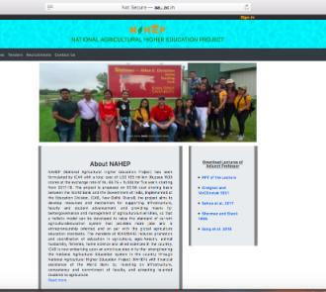
Meeting Time: 4 - 6 pm of February 21 & 28 (Friday)
Website for the presentations and some of the resources used
http://aau.ac.in/NAHEP/

Slide 3
What are the goals of Plant Breeders?
Develop cultivars in a timely manner.
Breeding objectives are decided by problem faced by farmers.
Climate change – becoming unpredictable weather patterns – challenging for breeder.
What’s becoming very urgent?
  Rapid development of new cultivars
  Precise plant breeding
  Design and develop new cultivars rapidly!

Slide 4
Lecture 6: Recent Advances in Plant Breeding (February 14)
Marker Assisted Selection
Speed Breeding
Doubled-haploid
TILLING Genome
CRISPR Cas9
Fixing Heterosis in Rice
Phenomics

Slide 5
Lecture 6: Recent Advances in Plant Breeding (February 21)
Marker Assisted Selection
Speed Breeding
Doubled-haploid
TILLING Genome
CRISPR Cas9
Fixing Heterosis in Rice
Phenomics

Slide 6
Some of the popular markers
RFLP: Restriction Fragment Length Polymorphism
RAPD: Random Amplified Polymorphic DNA
SSR: Simple Sequence Repeat
AFLP: Amplified Fragment Length Polymorphism
SNP: Single Nucleotide Polymorphism
GBS: Genotype by Sequencing
SBP: Sequenced-based Polymorphic marker

Slide 7
Restriction Fragment Length Polymorphism (RFLP)

Slide 8
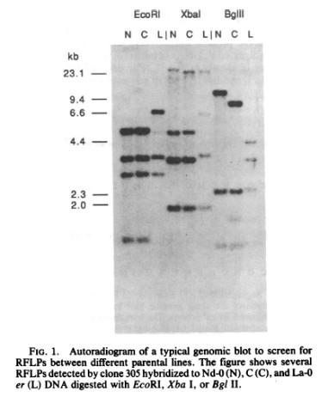
RFLP gel showing DNA fragment length polymorphisms.

Slide 9
Random Amplified Polymorphic DNA (RAPD)

Slide 10

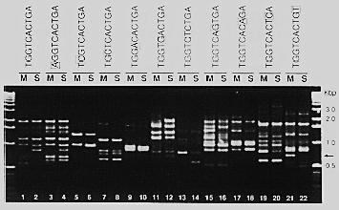
Random Amplified Polymorphic DNA (RAPD)
A single 10 nucleotide oligo anneal in opposite orientation and amplifies DNA.

Slide 11
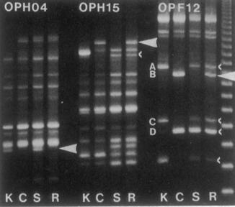

Slide 12
Simple Sequence Repeat (SSR)

Slide 13
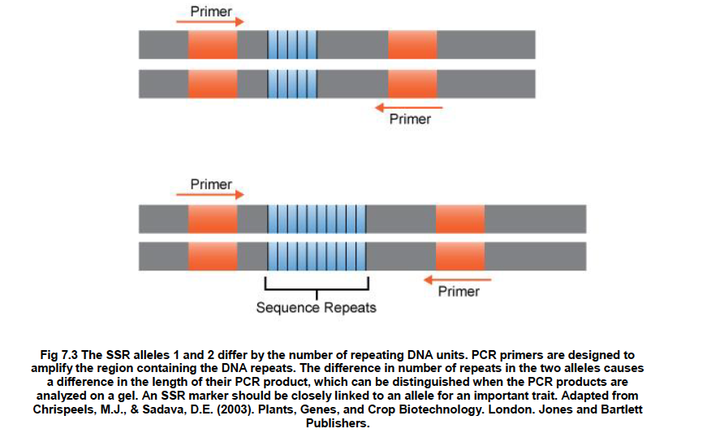
Two SSR alleles differing in repeat numbers produce PCR products that can be separated on an agarose gel.

Slide 14
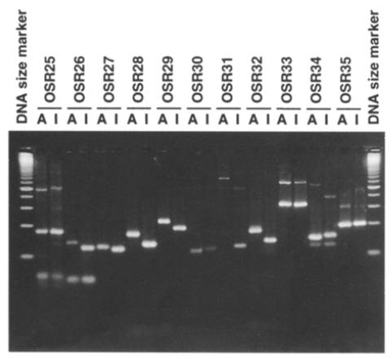
SSR markers are usually co-dominant.

Slide 15
AFLP: Amplified Fragment Length Polymorphism

Slide 16
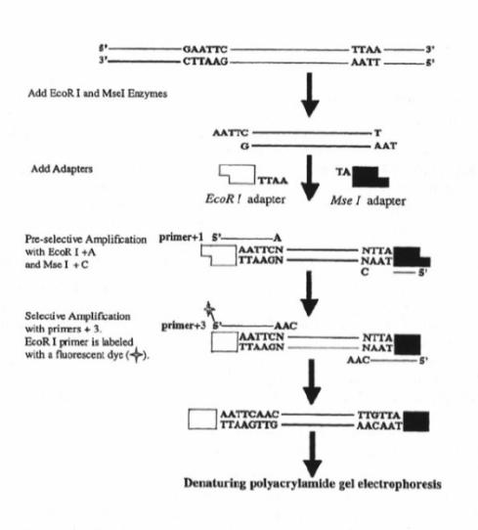
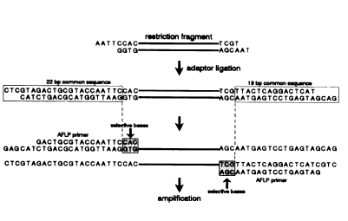
AFLP Technology
EcoRI
MseI
EcoRI
MseI

Slide 17
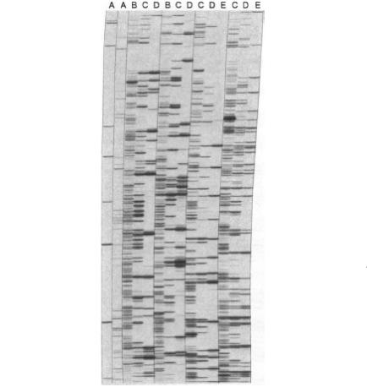
An AFLP Gel: Radio active label is used to detect the PCR amplified fragments.

Slide 18
Single Nucleotide Polymorphism (SNP)

Slide 19
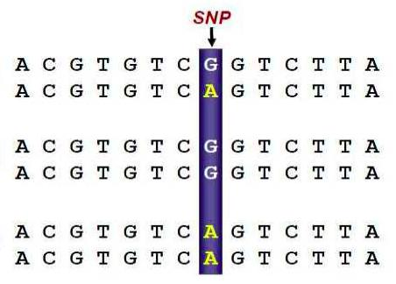
An example of SSR marker
Heterozygote
Homozygote
Homozygote

Slide 20
Genotype by Sequencing

Slide 21
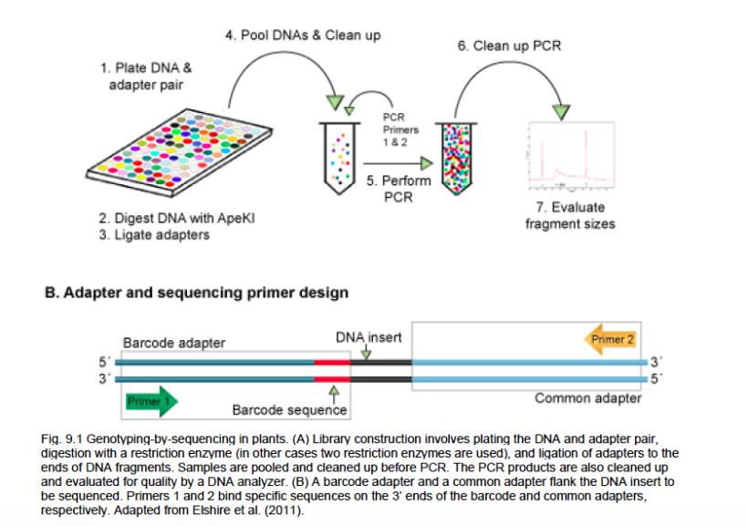

Slide 22
SBP: Sequenced-based Polymorphic marker

Slide 23
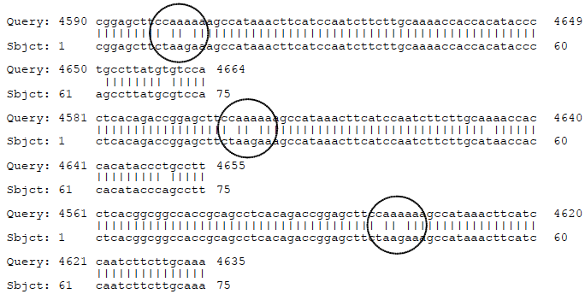
Comparison of sequences from two Arabidopsis ecotypes.

Slide 24
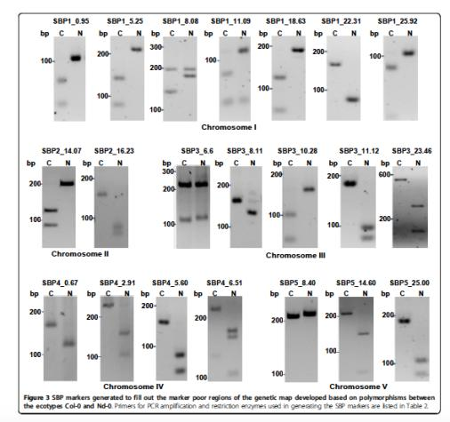
Sequence-based polymorphic (SBP) Markers that are polymorphic between Columbia -0 and Neiderzenz ecotypes.
Sahu et al. 2012

Slide 25
Rapid Identification of Linked Molecular Markers

Slide 26
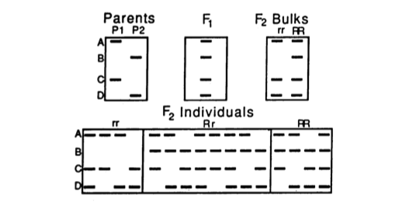
Bulked segregant Analysis
Michilemore et al. 1991

Slide 27
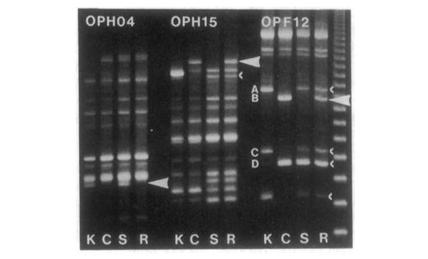
RAPD markers identified for the Dm5/8 region using BSA method in lettuce

Slide 28
Segregation of five SSR markers among 17 recombinant inbred lines RIL (F₇)

Slide 29
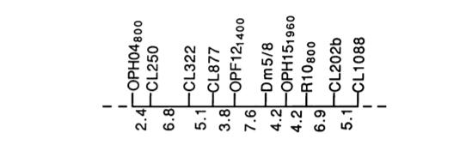
Genetic map developed for the Dm5/8 region using BSA method in lettuce.

Slide 30
Molecular marker assisted selection

Slide 31
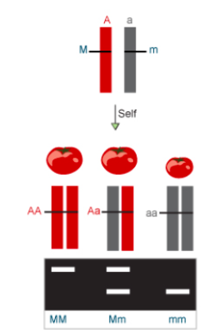
Molecular marker linked tightly to the fruit size trait for identifying homozygous (AA) lines.
Foreground Selection

Slide 32
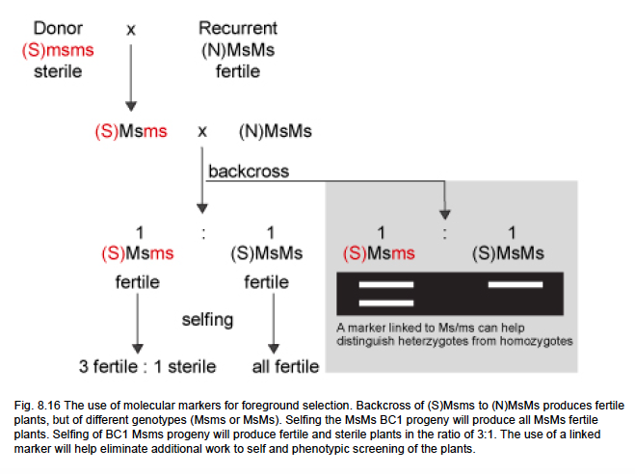
Molecular marker linked tightly to the male sterility trait for identifying the heterozygous (Msms) lines.
Foreground Selection

Slide 33
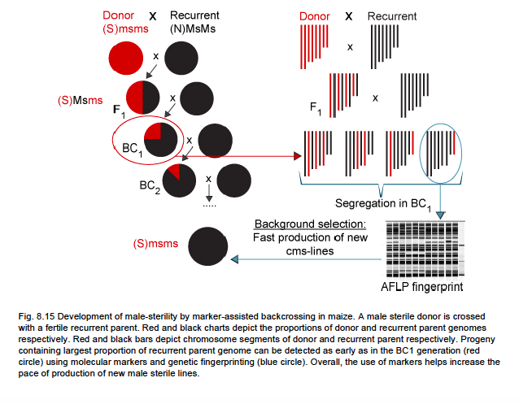
Marker-assisted backcrossing
Background Selection

Slide 34
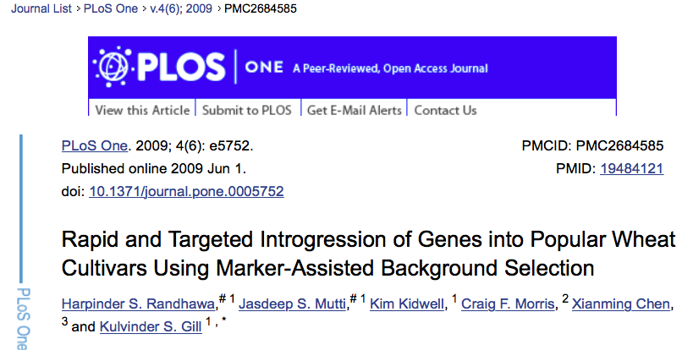

Slide 35
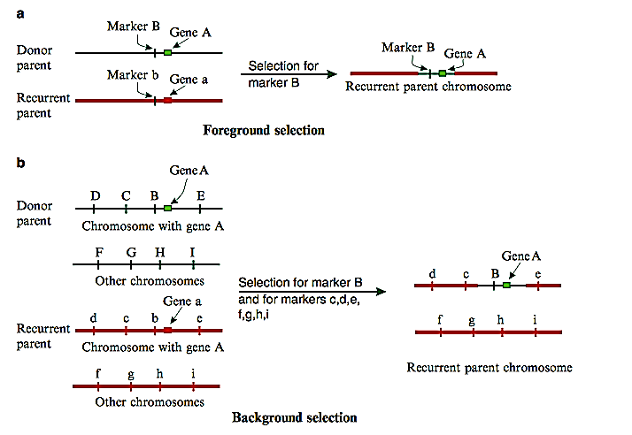
Foreground and Background Selection

Slide 36
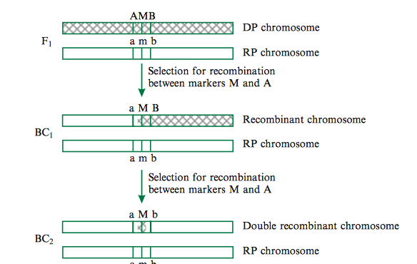
Recover the Double Recombinant to Eliminate any Linkage Drag

Slide 37
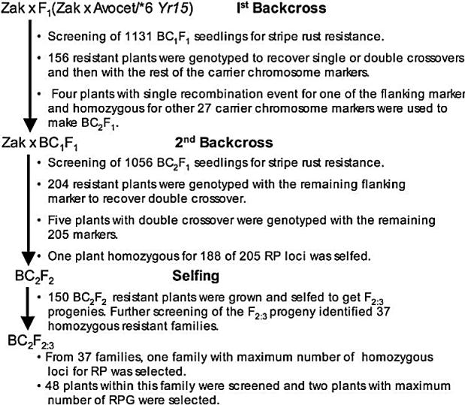

Slide 38
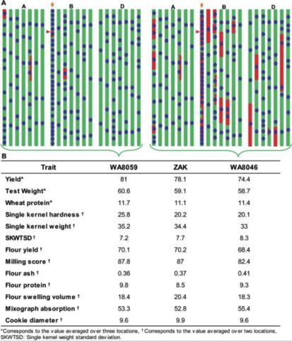
Comparison of cultivar ‘Zak’ derivatives carrying stripe rust resistance gene Yr15developed with (WA8059) and without (WA8046) MABS.

Slide 39
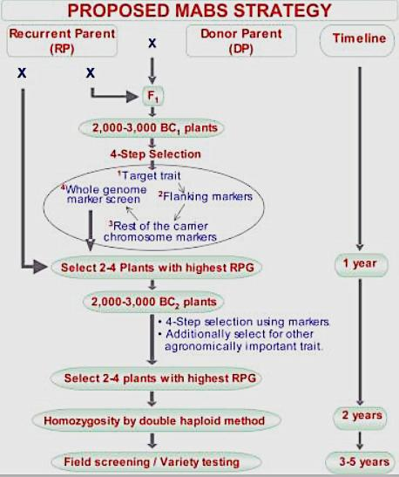

Slide 40
Marker-assisted Selection
In this study Randhawa et al. 2009 identified a BC₂F_{2:3} plant with 97% of the recurrent parent genome through marker-assietd background selection (MABS).
In contrast, only 82% of the recurrent parent genome was recovered in phenotypically selected BC₄F₇ plants developed without MABS.
Marker-assisted selection can also be applied to expedite pedigree or single seed descent method of breeding, if most desirable trait loci linked markers are known.

Slide 41
Lecture 6: Recent Advances in Plant Breeding (February 14)
Marker Assisted Selection
Speed Breeding
Doubled-haploid
TILLING Genome
CRISPR Cas9
Fixing Heterosis in Rice
Phenomics

Slide 42
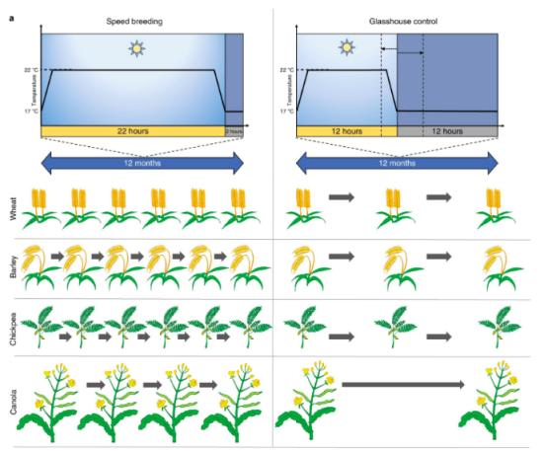
Speed breeding accelerates generation time of major crop plants for research and breeding
Speed Breeding
Greenhouse Control

Slide 43
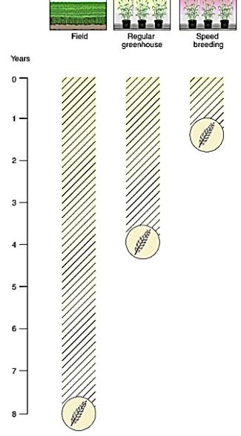

Slide 44
Steps to follow in Speed Breeding
Lights Quality: Light that produces a spectrum covering the PAR region (400–700 nm), with particular focus on the blue, red and far-red ranges, is suitable to use for SB.
Light Quantity: Intensity should very high: ~450–500 μmol/m2/s at plant canopy height effective for a range of crop species.
Photoperiod: We recommend a photoperiod of 22 h with 2 h of darkness in a 24-h diurnal cycle. The dark period slightly improves plant health.
Temperature: The optimal temperature regime (maximum and minimum temperatures) should be applied for each crop. A higher temperature should be maintained during the photoperiod, whereas a fall in temperature during the dark period can aid in stress recovery. A 12-h 22 °C/17 °C temperature cycling regime with 2 h of darkness occurring within 12 h of 17 °C has proven successful. A temperature cycling regime of 22 °C/17 °C for 22 h of light and 2 h of dark, respectively also work fine.
Humidity: Most controlled-environment chambers have limited control over humidity, but a reasonable range of 60–70% is ideal. For crops that are more adapted to drier conditions, a lower humidity level may be advisable

Slide 45
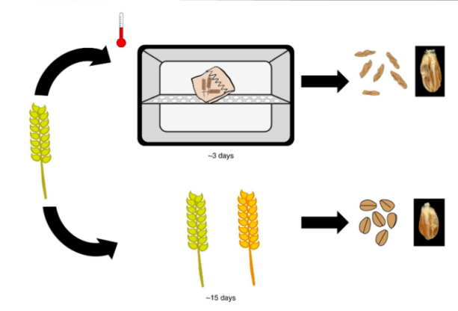
Harvesting of immature spikes and drying them in an oven/dehydrator saves 12 days (3 vs. 15 days)
~ 3 Days
~ 15 Days

Slide 46
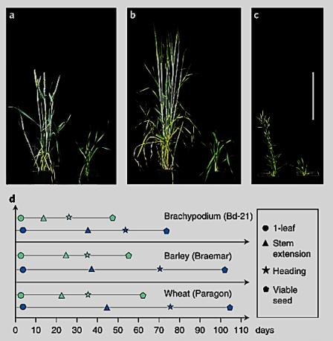
Accelerated plant growth and development under speed breeding (left) compared to control conditions (right).

Slide 47
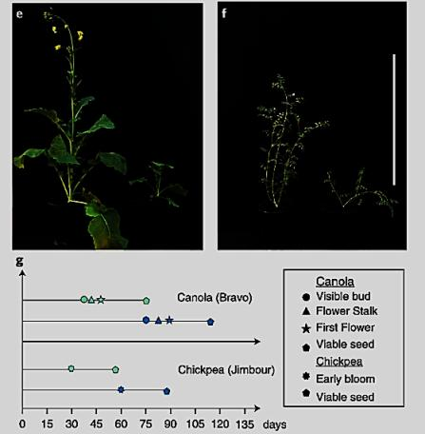
Accelerated plant growth and development under speed breeding (left) compared to control conditions (right).

Slide 48
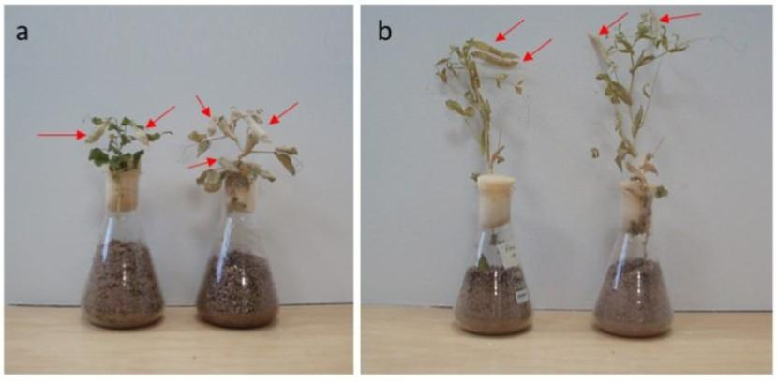
Peas mature in 8 instead of 12 weeks in greenhouse under normal condition.
Pea plants grown in limited media and nutrition (“flask method”) in order to achieve rapid generation advancement

Slide 49
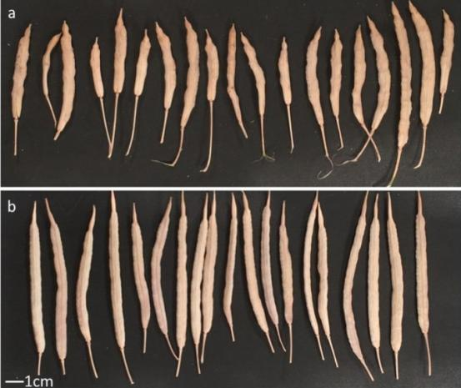
Pods harvested from Brassica napus RV31 grown in LED-supplemented glasshouses at the John Innes Centre, UK.
22-hour photoperiod
16-hour photoperiod

Slide 50
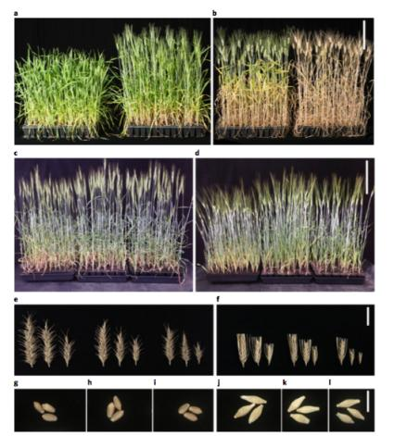
Fig. 2 | Single-seed descent sowing densities of spring wheat (bread and durum) and barley. All plants were grown under an LED-supplemented glasshouse setup at the JIC, UK, or the UQ, Australia. a,b, Durum wheat (T. durum cv. Kronos) grown under the LED-supplemented glasshouse setup, JIC, in 96-cell trays: 43 d after sowing, under a 16-h photoperiod (a, left); 43 d after sowing, under 22-h photoperiod (a, right); 79 d under a 16-h photoperiod (b, left); 79 d under a 22-h photoperiod (b, right). Scale bar, 20 cm (applies to a,b). c, Spring wheat (T. aestivum cv. Suntop) grown under an LED-supplemented glasshouse setup, at the UQ, at 37 d after sowing: plants in a 30-cell tray (left); plants in a 64-cell tray (center); plants in a 100-cell tray (right). d, Barley (H. vulgare cv. Commander) grown under an LED-supplemented glasshouse setup, at the UQ, at 34 d after sowing: plants in a 30-cell tray (left); plants in a 64-cell tray (center); plants in a 100-cell tray (right). Scale bar, 20 cm (applies to c,d). e, Mature spikes of spring wheat (T. aestivum cv. Suntop) grown under LED-supplemented glasshouse setup, at the UQ: spikes from plants in a 30-cell tray (e, left); spikes from plants in a 64-cell tray (e, center); spikes from plants in a 100-cell tray (e, right). f, Mature spikes of barley (H. vulgare cv. Commander) grown under an LED-supplemented glasshouse setup, at the UQ: spikes from plants in a 30-cell tray (f, left); spikes from plants in a 64-cell tray (f, center); spikes from plants in a 100-cell tray (f, right). Scale bar, 3 cm (applies to e,f). g–i, Mature seeds of spring wheat (T. aestivum cv. Suntop) grown under an LED-supplemented glasshouse setup, at the UQ: seeds from plants in a 30-cell tray (g); seeds from plants in a 64-cell tray (h); seeds from plants in a 100-cell tray (i). j–l, Mature seeds of barley (H. vulgare cv. Commander) grown under an LED-supplemented glasshouse setup, at the UQ: seeds from plants in a 30-cell tray (j); seeds from plants in a 64-cell tray (k); seeds from plants in a 100-cell tray (l). Scale bar, 1 cm (applies to g–l).
Single-seed descent sowing densities of spring wheat (bread and durum) and barley.

Slide 51
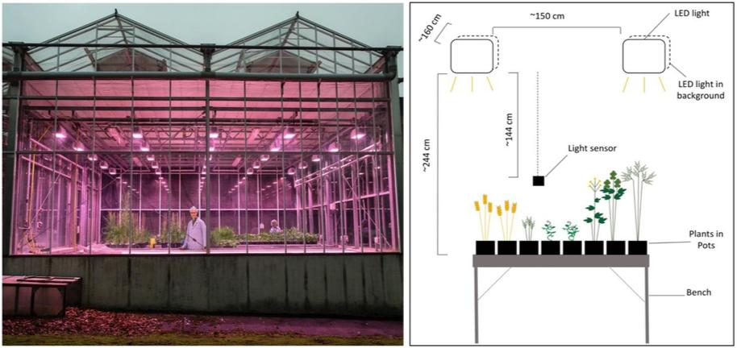

Slide 52
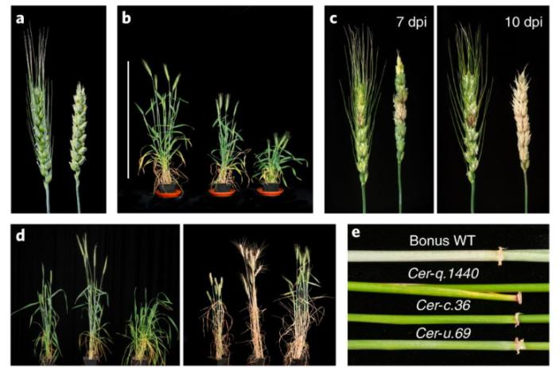
Adult plant phenotypes in wheat and barley under speed breeding conditions
Fig. 3: Adult plant phenotypes in wheat and barley under speed breeding conditions.

Slide 53
Speed Breeding Expedites the Development of Novel Cultivars
One can now generate novel cultivars very rapidly. Four to six crops a year?
Single seed descent (SSD) method can be pursued under speed breeding without any trade off.
In fact, becomes less expensive to grow thousands of lines densely under greenhouse condition for SSD.
Selection can be made for disease resistance in adult plants.
General methodologies work for most if not all crop plants; but modification can help.

Slide 54
Lecture 6: Recent Advances in Plant Breeding (February 14)
Marker Assisted Selection
Speed Breeding
Doubled-haploid
TILLING Genome
CRISPR Cas9
Fixing Heterosis in Rice
Phenomics

Slide 55
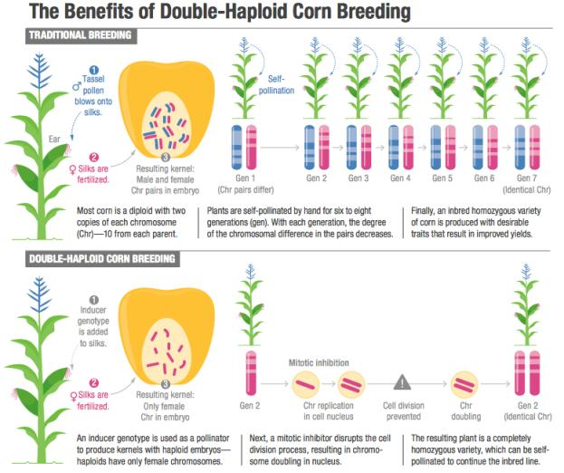

Slide 56
Doubled-haploid to Expedite the Breeding Program
We need to fix the inbred lines for heterosis breeding.
Doubled-haploid approach fix the genome in one generation.
Process is time and labor-intensive.
Recombination in one step as opposed to additional recombination in selfing generations of the pedigree/SSD method.

Slide 57
Lecture 6: Recent Advances in Plant Breeding (February 14)
Marker Assisted Selection
Speed Breeding
Doubled-haploid
TILLING Genome
CRISPR Cas9
Fixing Heterosis in Rice
Phenomics

Slide 58
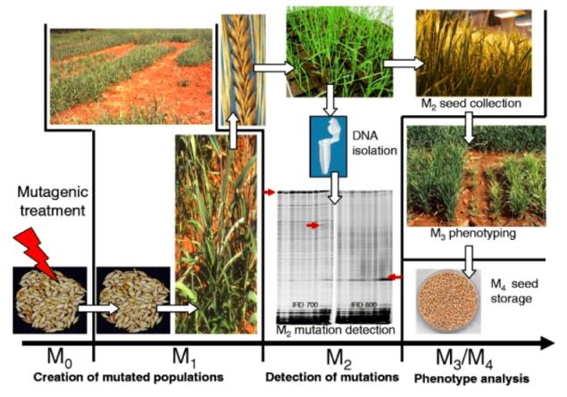
Targeting Induced Local Lesions IN Genomes (TILLING)

Slide 59
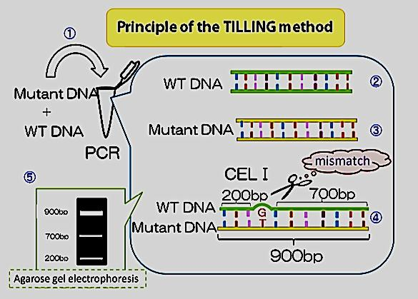

Slide 60
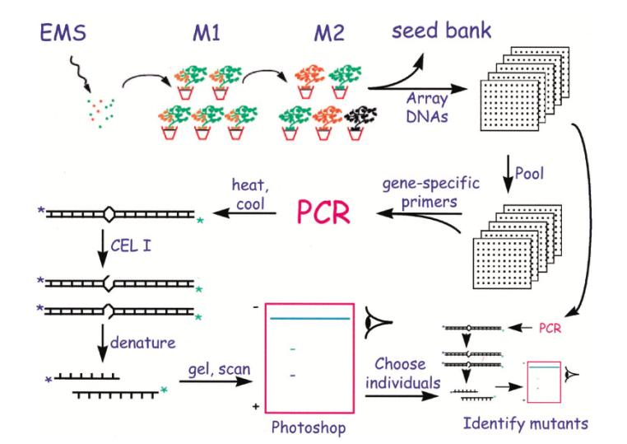

Slide 61
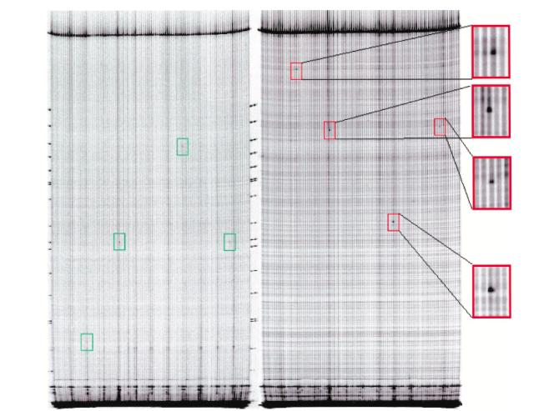
TILLING Results for A Target Gene

Slide 62
Targeting Induced Local Lesions IN Genomes (TILLING)
Intended for reverse genetics – means we look for mutations in the target gene.
The resource can also be screened/phenotyped for traits of interest and apply positional gene cloning – forward genetics.
Applied extensively across crop species.
One can create desirable mutants for a trait gene instead of gene silencing or knockout or editing – GMO free.

Slide 63
Lecture 6: Recent Advances in Plant Breeding (February 14)
Marker Assisted Selection
Speed Breeding
Doubled-haploid
TILLING Genome
CRISPR Cas9
Fixing Heterosis in Rice
Phenomics

Slide 64
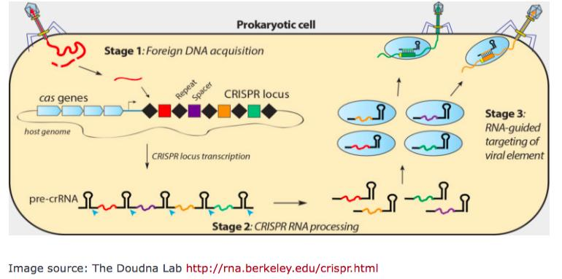
Innate Immunity in Prokaryote
The Clustered Regularly Interspaced Short Palindromic Repeats, or CRISPR

Slide 65
The Clustered Regularly Interspaced Short Palindromic Repeats, or CRISPR was first discovered in 1993 through sequence analyses.
Significance of CRISPR was unknown until 2007, when immunity function of this element was uncovered.
The mechanism used by the element to confer immunity became known after five years
The bacteria and archaea use CRISPR to defend against the invading viruses termed as bacteriophages. Following viral infection, they employ a special CRISPR-associated nuclease 9 (Cas9) to generate a double-strand break (DSB) in its target loci of the bacteriophages’ DNA molecules. Thus, viruses become ineffective. Cas9 is directed to the target sequence by a short RNA fragment known as a guide RNA (gRNA), complementary to a segment of the viral genome for generating DSB. Parallel to viral DNA cleavage, a short viral DNA is stored between the palindromic CRISPR sequences. This sequence is being used to generate the gRNA for rapid activation of this defense mechanism against any subsequent infection by the same bacteriophage. This system is kind of similar to antibody production in humans.

Slide 66
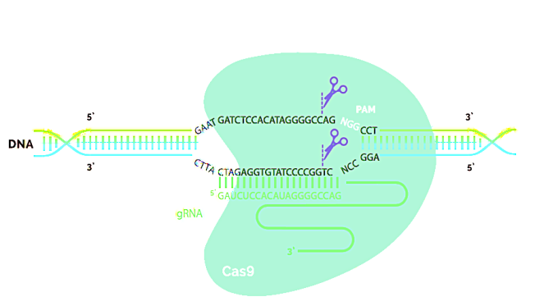
CRISPR-Cas9 System
The CRISPR-Cas9 system comprises a guide RNA (gRNA) and Cas9 nuclease, which together form a ribonucleoprotein (RNP) complex. The gRNA binds to the genomic target upstream of a protospacer adjacent motif (PAM), enabling the Cas9 nuclease to make a double-strand break in the DNA (denoted by the scissors). Adopted from: https://www.synthego.com/resources/crispr-101-ebook

Slide 67
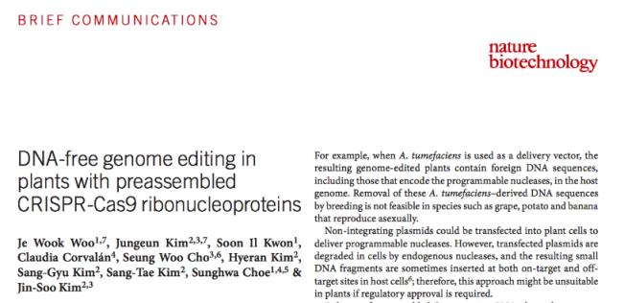
DNA-free genome editing in plants with preassembled CRISPR-Cas9 ribonucleoproteins

Slide 68
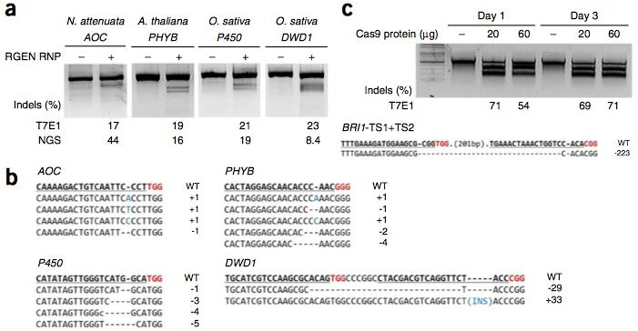
RNP-mediated gene disruption in plant protoplasts of Nicotiana attenuata, Arabidopsis thaliana and Oryza sativa.

Slide 69
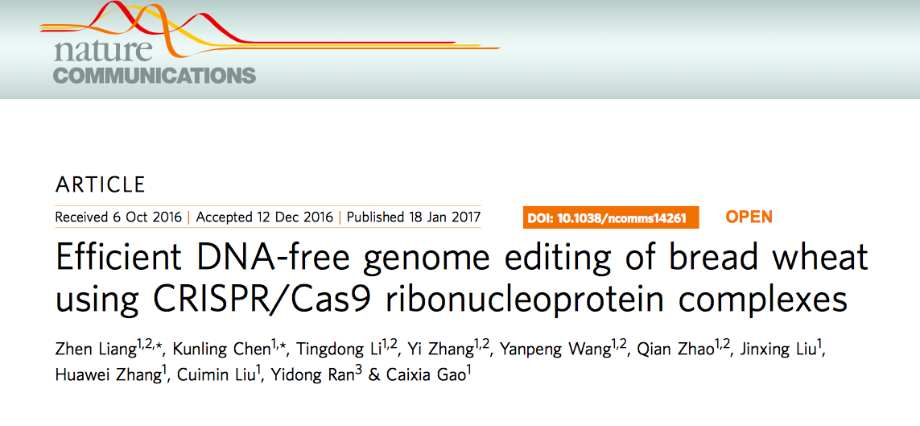

Slide 70
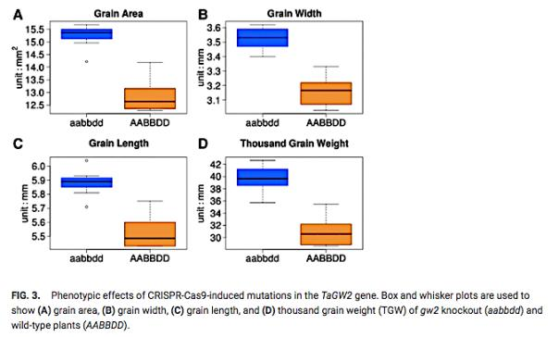
The knockout mutations in all three homoeologous copies of one of the target genes, TaGW2, resulted in a substantial increase in seed size and thousand grain weight.
Wang et al. 2018

Slide 71
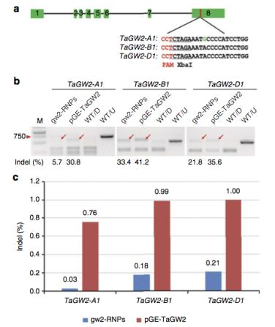
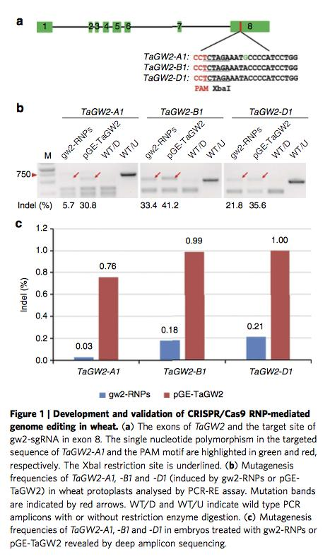
Efficient DNA-free genome editing of bread wheat using CRISPR/Cas9 ribonucleoprotein complexes

Slide 72
Efficient DNA-free genome editing of bread wheat using CRISPR/Cas9 ribonucleoprotein complexes
The avoidance of transgene integration and reduction of off-target mutations are two most important issues in gene editing.
Liang et al. (2017) described an efficient genome editing method for bread wheat using CRISPR/Cas9 ribonucleoproteins (RNPs).
The whole protocol takes only seven to nine weeks, with four to five independent mutants produced from 100 immature wheat embryos. Delivery system was a gun.
Deep sequencing revealed no off-target mutations in wheat cells in RNP mediated genome editing method.
Because no foreign DNA is used in CRISPR/Cas9 RNP mediated genome editing, the mutants obtained are completely transgene free.
This method may be widely applicable for producing genome edited crop plants and has a good prospect of being commercialized.

Slide 73
Lecture 6: Recent Advances in Plant Breeding (February 14)
Marker Assisted Selection
Speed Breeding
Doubled-haploid
TILLING Genome
CRISPR Cas9
Fixing Heterosis in Rice
Phenomics

Slide 74
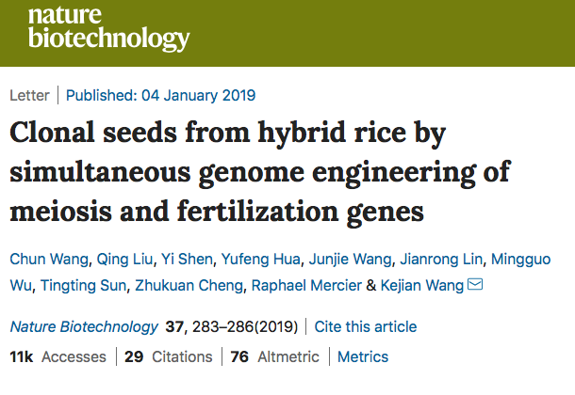

Slide 75
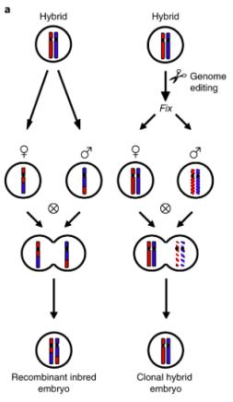
Fixation of Heterozygosity in Rice Through Editing Four Genes.

Slide 76
Heterosis or hybrid vigor enhances crop yield. Example; maize
Unfortunately, most staple food and legume crops are self-pollinated.
Generation and identification of male sterility gene have been long attempted with a view to exploit heterosis.
Clonal propagation through seeds would enable self-propagation of F₁ hybrids in self or cross pollinated crop species.
Wang et al. (2019) reported a strategy to enable clonal reproduction of F₁ rice hybrids through seeds.
Conducted multiplex CRISPR–Cas9 genome editing of the REC8, PAIR1 and OSD1 meiotic genes to produce clonal diploid gametes and tetraploid seeds.
Next, they editing the MATRILINEAL (MTL) gene (involved in fertilization) to induce formation of haploid seeds in hybrid rice.
Finally, simultaneous editing of all four genes (REC8, PAIR1, OSD1 and MTL) in hybrid rice led them to propagate F₁s clonally through seeds.

Slide 77

a, The structure of CRISPR–Cas9 vector targeting OSD1, PAIR1 and REC8.
b, The chromosomes of CY84 and Mitosis instead of Meiosis (MiMe) were probed by digoxigenin-16-dUTP-labeled 5 S rDNA (red signal, indicated with a white arrow) in spores, showing one signal in wild-type CY84 and two signals in MiMe. The DNA is stained with 4′,6-diamidino-2-phenylindole (DAPI, blue signal). Scale bars, 5 μm.

Slide 78

Turning meiosis into mitosis in hybrid rice variety CY84.
c, Panicles of wild-type CY84 and MiMe. The fertility of MiMe was as high as that of wild-type CY84.
d, Ploidy analysis of CY84 (left) and the progeny of MiMe (right) by flow cytometry, which were found to be diploid and tetraploid, respectively.
e, Genotype analysis of the paternal C84, maternal Chunjiang 16 A (16 A), hybrid variety CY84 and the progeny siblings of MiMe. Ten indel markers distributed on chromosomes 1 and 8 were used to identify the genotype of the offspring of MiMe. Positions of markers (brown) and centromeres (black) are indicated along the chromosomes. For each marker, plants carrying the C84 allele are in red, plants carrying the 16 A allele are in blue, and plants with both C84 and 16 A alleles appear in yellow. Each row represents one plant, and each column indicates a locus.
f, Panicles and grain shape of CY84 and the progeny of MiMe. The progeny of MiMe displayed reduced fertility, increased glume size and elongated awn length. Scale bars, 2 cm.

Slide 79

Generation of a haploid inducer line by editing the MTL gene involved in fertilization in hybrid rice variety CY84.

Slide 80


Slide 81
Generation of a haploid inducer line by editing the MTL gene involved in fertilization in hybrid rice variety CY84.

Slide 83
Fixation of Heterozygosity in Rice Through Editing Four Genes.
Two biological steps were modified to fix heterozygosity in rice.
In step 1, three genes edited to generate a mutant known as “Mitosis instead of Meiosis (MiME).”
In the Step 2, a single mutation to avoid fertilization is generated.
Gene editing for all four genes resulted in seeds that carry the genotype of the F₁.
You end up two copies of the haploid F₁ genome; without going through meiosis (crossing over, etc.).
The gametes are as a result diploids.
Mutation in the fertilization gene suppressed the fusion of male gamete with the novel diploid ovum.
The diploid ovum generates the embryo and then the seeds as in apospory.
Poor seed setting of these novel F₁s will require some more work to improve fertility. Okay to use in fodder crops grown for foliage only.

Slide 84
Lecture 6: Recent Advances in Plant Breeding (February 14)
Marker Assisted Selection
Speed Breeding
Doubled-haploid
TILLING Genome
CRISPR Cas9
Fixing Heterosis in Rice
Phenomics

Slide 85
Phenomics
https://www.youtube.com/watch?v=ZF2fuftRl_4
https://www.youtube.com/watch?v=IgpiEla4r2E

Slide 86


Slide 87
Why Phenomics?
There are 40-60 thousands genes in the genome. How do we do MAS, CRISPR, TILLING, or any of it, if we do not know what do they do?
Phenomics will therefore continue to play a major role for the times to come.
Digital phenotyping is objective with no possibility of human errors. Robust and doable for a large experiments in multiple environments.
The approach we can apply is to generate a large segregating population – say 4,000 recombinant inbred lines through Fast Breeding.
We select say 400 from this 4,000 lines randomly to phenotype and identify markers linked to the trait loci.
Once the trait loci and associate markers are identified, we can use these markers to select the desirable genotypes from the entire population of 4,000 RILs.

Slide 88
Any Question?
Expedite plant breeding
Precession plant breeding

Slide 89
Thank you!

