Slide 1
Lecture 1- Genetics
4 to 6 PM of February 3, 2020
Meiosis
Recombination
Segregation
Independent Assortment & Linkage
Genetic & Physical Maps
Madan K. Bhattacharyya, Ph.D.
Professor, Iowa State University
Adjunct Prof., Assam Agricultural University
mbhattac@iastate.edu

Slide 2
Lecture 1. Genetics
Lecture 2: Molecular Genetics
Lecture 3: Molecular Markers and Molecular Breeding
Lecture 4: Transgenic Technology
Lecture 5: Gene editing using CRISPR Cas Technology
Lecture 6: Recent Advances in Plant Breeding

Slide 3
Meiosis Generates Genetic Variation

Slide 4
Flowers - where the journey begins for generating novel genetic variation!

Slide 6
Major differences between Mitosis and Meiosis

Slide 7
Generation of novel chromatids through crossing over at the end Meiosis I
Equational Separation
Reductional Separation

Slide 8
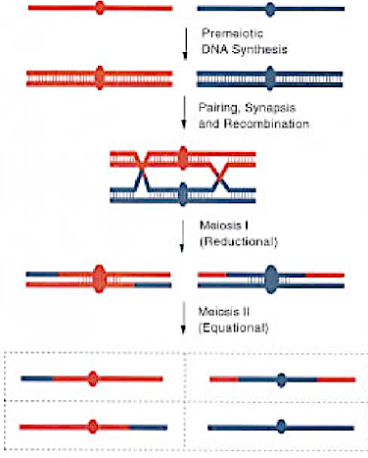
Type of Separations During Meiosis I and Meiosis II: Centromere
Reductional
Equational
Equational
Reductional

Slide 9
Chromosomal Separations in Meiosis
Sister chromatids go to same pole at anaphase I.
The kinetochore ("spindle attachment”) always separates reductionally at anaphase I
A locus some distance from the centromere will separate reductionally or equationally depending on the number of cross-over events between the locus and the centromere.
Thus, a locus separated by one crossover from the centromere will separate equationally at anaphase I and reductionally at anaphase II.
Any plant breeding implications?

Slide 10
Recombination

Slide 11
A high-resolution physical recombination map for tomato chromosomes
Recombination Nodules (RN) in Tomato
Sherman and Stack 1995

Slide 13
Distribution of RNs on tomato synaptonemal complexes (SCs).
Acrocentric Chromosomes

Slide 14
Recombination is suppressed in the heterochromatic region containing the centromere.
Blue line: Williams 82 × PI479752
Red Line: Essex × Williams 82
SNP: single nucleotide polymorphism
Song et al. (2016) BMC Genomics 17:33

Slide 15
Recombination is suppressed in the heterochromatic region containing the centromere.
Blue line: Williams 82 × PI479752
Red Line: Essex × Williams 82
SNP: single nucleotide polymorphism
Song et al. (2016) BMC Genomics 17:33

Slide 16
Different recombination rates across the chromosomes.
Recombination rates are highly suppressed in the heterochromatic regions containing the centromeres.
Genetic and physical maps do not have any linear relationships.
Rare recombination rates in heterochromatic areas depict tight linkages between genes and/or markers. In fact, 10 -100 times more physical distances/cM in heterochromatic regions observed as compared to that in the euchromatic regions.
Any plant breeding implications?

Slide 17
Segregation

Slide 18
Mendel's laws of inheritance
Law | Definition
Law of dominance | Some alleles are dominant while others are recessive; an organism with at least one dominant allele will display the effect of the dominant allele.
Law of segregation | During gamete formation, the alleles for each gene segregate from each other so that each gamete carries only one allele for each gene.
Law of independent assortment | Alleles of genes governing different traits can segregate independently during the formation of gametes.

Slide 19
Law of segregation

Slide 20
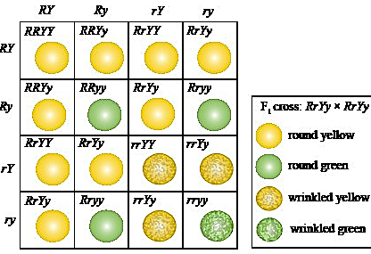
Law of independent assortment
R-Y-:R-yy:rrY-:rryy:: 9:3:3:1

Slide 21
Segregation of genetic loci

Slide 22
Law of segregation

Slide 23
Determine if observed segregation fits any genetic ratio.

Slide 24
Determine if observed segregation fits any genetic ratio.
Segregation of flower color in Antirrhinum majus.
Null Hypothesis: The observed ratio does not fit the 3:1 ratio.
Alternate Hypothesis: Fits the 3:1 ratio

Slide 25
Segregation of Genetic Loci
Alleles of genetic loci segregates and generates recombinants.
Recombinants are novel genotypes with new combination of genes or alleles.
Chi-square test allows defining segregating ratios and gene actions.
Any plant breeding implications?

Slide 26
Independent Assortment & Linkage

Slide 27
Independent Assortment & Coupling and Repulsion Phase Linkages
A
Coupling Phase Linkage
A
Repulsion Phase Linkage
B
b
Independent Assortment
> 50 cM
C
C

Slide 28
Detection of Linkage
A
a
b
B

Slide 29
Detection of Linkage
A
a
B
b

Slide 30
Detection of Linkage
A
B
Independent Assortment
> 50 cM
> 50 cM
C

Slide 31
Detection of Linkage: Example
F₂ data for cr (crinkly dwarf) vs. ms (male sterile)
cr-ms x Normal (double mutant was crossed with the wild-type) (coupling phase cross)
a = 181, b = 33, c = 35, d = 30; N = 279
AB (a)
Ab (b)
aB (c)
ab (d)
Quick test: (181 x 30)/(33 x 35) = 4.7 (coupling linkage as > 1).

Slide 32
Independent Assortment and Linkage
Relative positions of two genetic loci determines if independent assortment or linkage will prevail between them.
Coupling and repulsion phase linkages produce different proportions of recombinants.
Coupling phase linkage is more sensitive to determine the recombination percentage as compared to repulsion phase linkage.
Any plant breeding implications?
Repulsion
Coupling

Slide 33
Genetic & Physical Maps

Slide 34
Map of the cytological and morphological markers of maize chromosome 9 based on crossing over frequencies.
Cytological crossing over correlated with the genetic crossing over.
Creighton and McClintock, 1931

Slide 35

Genetic Map
Physical Map
cM
cM
Mb
Mb
Sahoo DK, Abeysekara NS, Cianzio SR, Robertson AE, Bhattacharyya MK (2017) A Novel Phytophthora sojae Resistance Rps12 Gene Mapped to a Genomic Region That Contains Several Rps Genes. PLOS ONE 12(1): e0169950. https://doi.org/10.1371/journal.pone.0169950
https://journals.plos.org/plosone/article?id=10.1371/journal.pone.0169950

Slide 36
Genetic and Physical Maps
Genetic map is based on recombination percentage; cM units.
Physical map denotes actual physical distances in Kb (1,000 base pairs) or Mb (1 million bp) units.
Relationship between the two maps varies across a chromosome; with more crossing overs in the euchromatic regions and much reduced number in the heterochromatic regions.
1 cM could be around 100 Kb or less in euchromatic regions; whereas, ~1-4 Mb or more in the heterochromatic regions.
Any plant breeding implications?

Slide 37
Let’s discuss more!

Slide 38
Metacentric Chromosomes
Metacentric chromosomes have the centromere in the center, such that both sections are of equal length.
Submetacentric Chromosomes
Submetacentric chromosomes have the centromere slightly offset from the center leading to a slight asymmetry in the length of the two sections.
Acrocentric Chromosomes
Acrocentric chromosomes have a centromere which is severely offset from the center leading to one very long and one very short section.
Telocentric Chromosomes
Telocentric chromosomes have the centromere at the very end of the chromosome.

