Slide 1
Lecture 1. Genetics (February 18)
Lecture 2: Molecular Genetics (February 18)
Lecture 3 Recent Advances in Plant Breeding (February 19)
Madan K. Bhattacharyya, Ph.D.
Professor, Iowa State University
Adjunct Prof., Assam Agricultural University
mbhattac@iastate.edu

Slide 2
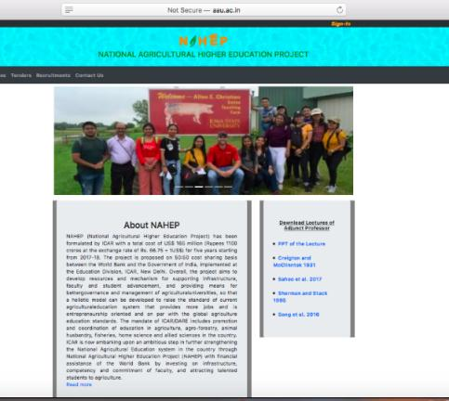
Website for the presentations and papers
http://aau.ac.in/NAHEP/

Slide 3
Lecture 2 - Molecular Genetics
2 to 4 PM of February 18, 2020
Gene structure
Transcription
Translation
Central dogma
Metabolites and metabolic pathway
Molecular basis of phenotypes

Slide 4
Gene Structure

Slide 5
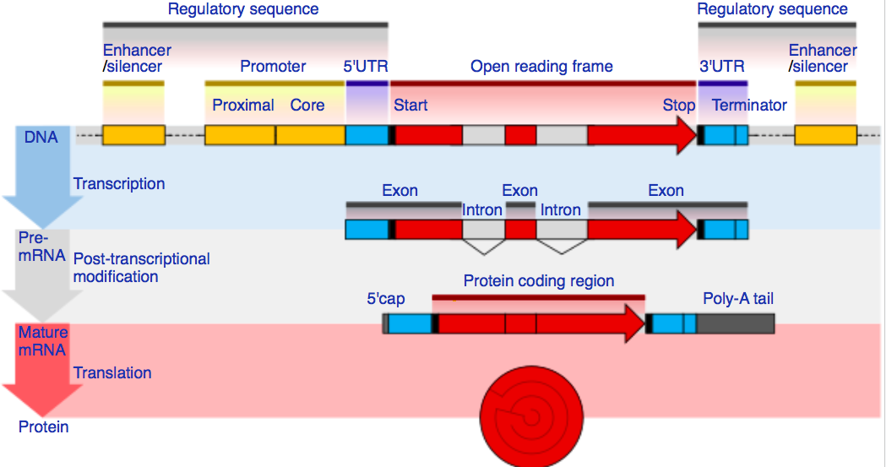
Gene Structure in Eukaryotes

Slide 6
Transcription

Slide 7
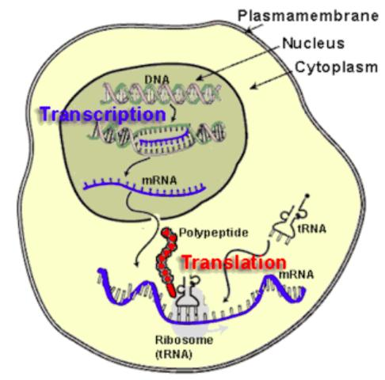
Transcription in an Eukaryotic Cell

Slide 8
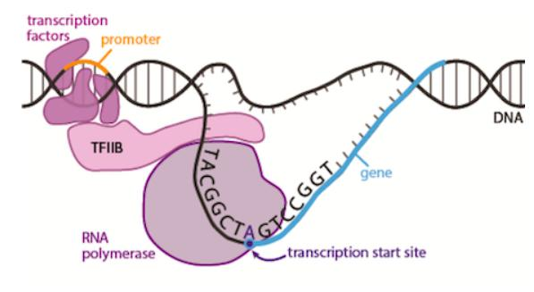
Transcription

Slide 9
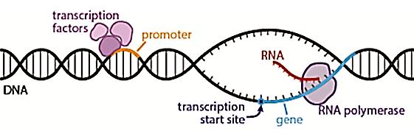
Transcription

Slide 10
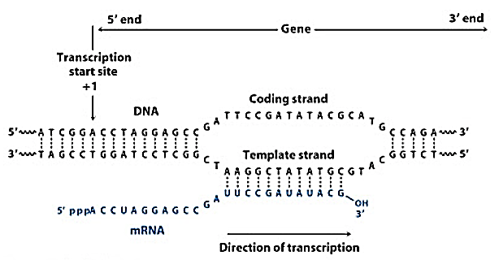
Transcription

Slide 11
Translation

Slide 12
Translation in an Eukaryotic Cell

Slide 13
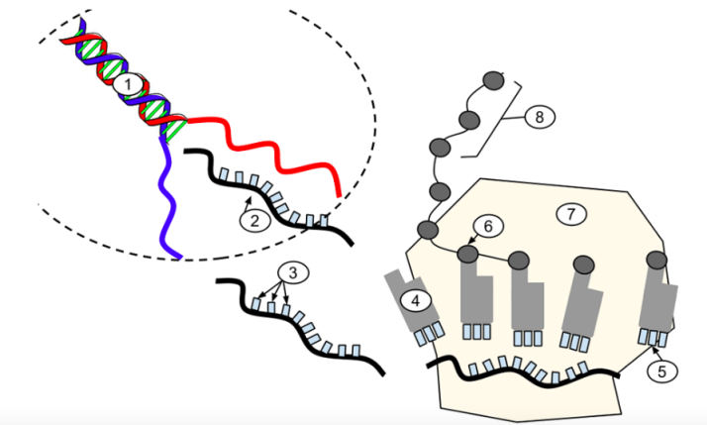
Translation

Slide 14
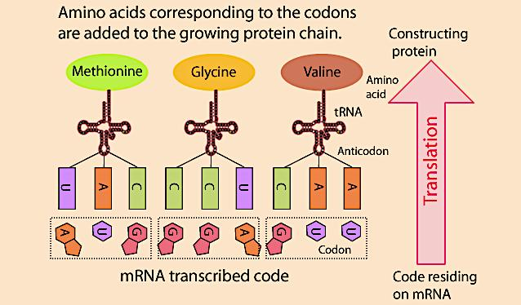
Translation

Slide 15
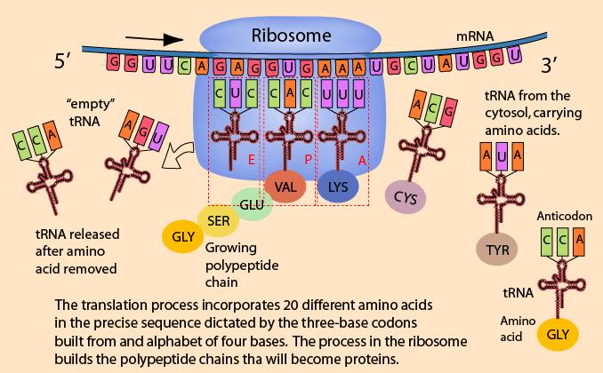
Translation

Slide 16
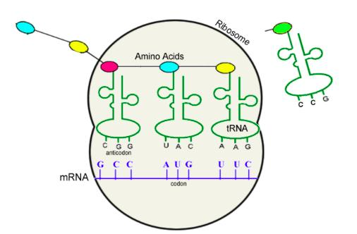
Translation

Slide 17
The Central Dogma in Molecular Biology

Slide 18
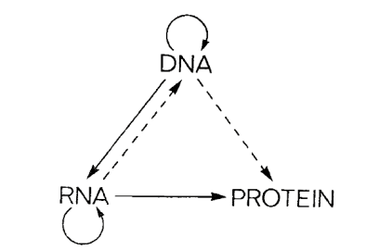
The central dogma of molecular biology is an explanation of the flow of genetic information within a biological system.
Francis Crick (1958, 1970)
“The central dogma of molecular biology deals with the detailed residue-by-residue transfer of sequential information. It states that such information cannot be transferred from protein to either protein or nucleic acid.”
Francis Crick (1970)

Slide 19
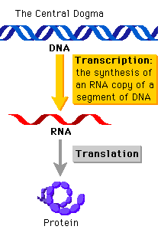
The central dogma of molecular biology is an explanation of the flow of genetic information within a biological system.
Jim Watson (1965) in the first edition of The Molecular Biology of the Gene described this simple version.

Slide 20
What is a gene?
The first mention of gene was made by Mendel.
He explained his results in terms of discrete inherited units (now known as genes) that give rise to observable physical characteristics.
In 1905, Johannsen introduced the term 'gene' and in 1908, Bateson termed genetics.
Today you have learned that a gene, a DNA segment, contains information for a protein that mediates gene-function.
This is the central dogma of molecular biology "DNA makes RNA and RNA makes protein.”

Slide 21
We now know much more than 1950s or 1960s!
Is the central dogma still relevant?

Slide 22
Not really – some of the exceptions are listed below:
Same gene may have splice variants with distinct regulatory functions; e.g. tobacco N gene encoding TMV resistance
Multiple subunits of an enzyme could be encoded by a number of genes.
t-RNA genes for t-RNAs involved in protein synthesis.
snRNA genes for snRNAs involved in splicing pre-mRNAs.
Ribosomal genes for rRNAs involved in protein synthesis.
Micro-RNAs with regulatory functions.
Prions can make more prions from normal proteins.

Slide 23
Metabolites and Metabolic Pathway

Slide 24
Metabolites are closest to phenotypes
Genes
mRNAs
Proteins
Metabolites
Phenotypes

Slide 25
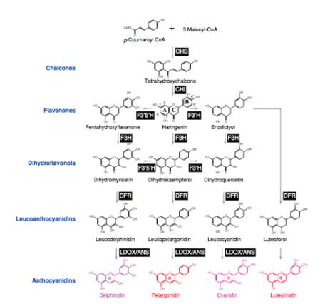

Biosynthetic pathway of four major classes of anthocyanins
Biosynthesis of the 4 major classes of anthocyanins (Grotewold, 2006). Names of compounds are indicated and enzymes, in black boxes, are as follows: CHS, chalcone synthase; CHI, chalcone isomerase; F3H, flavanone 3-hydroxylase; F3’H, flavanone 3’-hydroxylase; F3’,5’H, flavanone 3’,5’-hydroxylase; DFR, dihydroflavonol 4-reductase; LDOX/ANS, leucoanthocyanidin dioxygenase/anthocyanidin synthase. Grotewold E. 2006, Annu. Rev. Plant-Biol. 57:761-80.

Slide 26
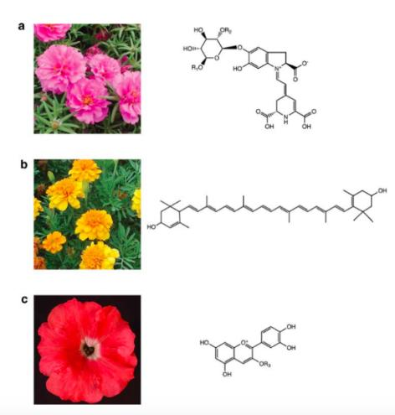
Metabolites provide the petal color phenotypes.
Flower displaying the three major types of pigments and the corresponding structures.
(a) Portulaca (Portulaca grandiflora) flowers accumulating primarily the betalain pigment, betanin (R1 = R2 = H).
(b) Marigold (Tagetes patula) flowers accumulating the carotenoid pigment, lutein.
(c) Petunia (Petunia hybrida) flower accumulating an anthocyanidin, cyanidin.
Grotewold E. 2006, Annu. Rev. Plant-Biol. 57:761-780

Slide 27
Molecular Basis of Phenotypes

Slide 28
Wrinkled Pea Seed
Variegated Soybean Flower

Slide 29
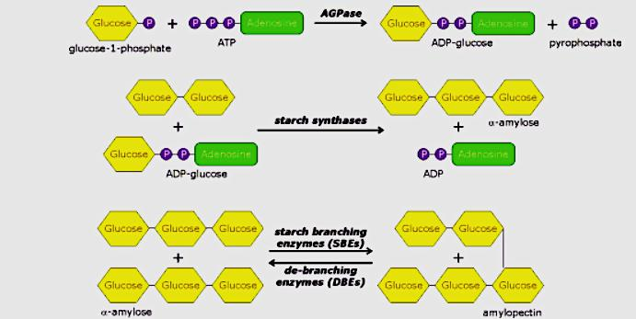
Starch Biosynthetic Pathway

Slide 30
Starch Biosynthetic Pathway in r Pea Mutant
40% to 65%
X
45% to 32%

Slide 31
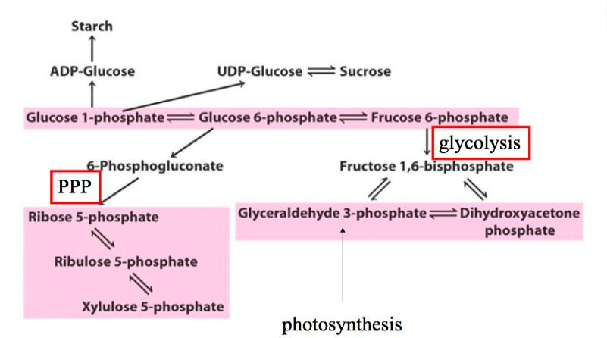
The r pea mutant
10% from 6% in Sweet Peas

Slide 32
Starch Branching Enzyme I is Impaired in the r Pea Mutant
40% to 65%
X
45% to 32%

Slide 33
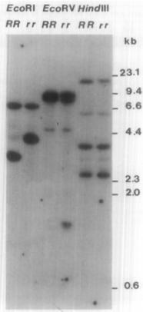
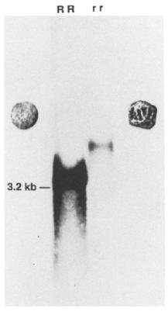
A transposon-like insertion caused mutation in a starch branching enzyme gene located in the r locus studied by Gregor Mendel.
DNA blot
RNA blot
Southern blot
Northern blot
Bhattacharyya et al. 1990

Slide 34
How does wrinkled seed phenotype develop in the sweet r mutant?
Lack of SBEI
Low Amylopectin and High Amylose
Sugars Increased from ~ 6 to 10%
Increased Osmotic Potential
Higher Water Uptake During Seed Development
Cell Shrinking During Seed Maturation
Wrinkled Seeds
Bhattacharyya et al. 1993

Slide 35
Variegated Flower Phenotype

Slide 36
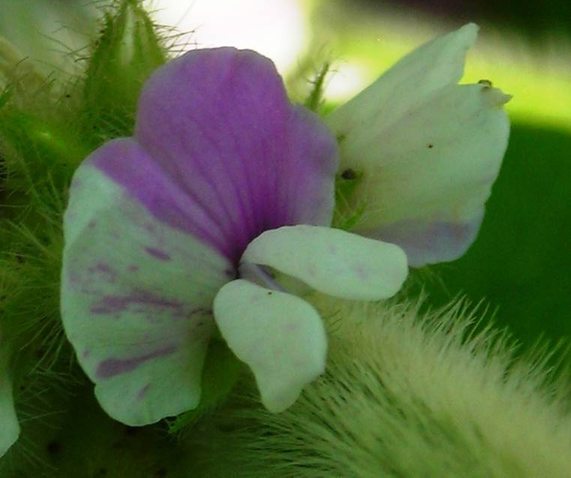

Slide 37
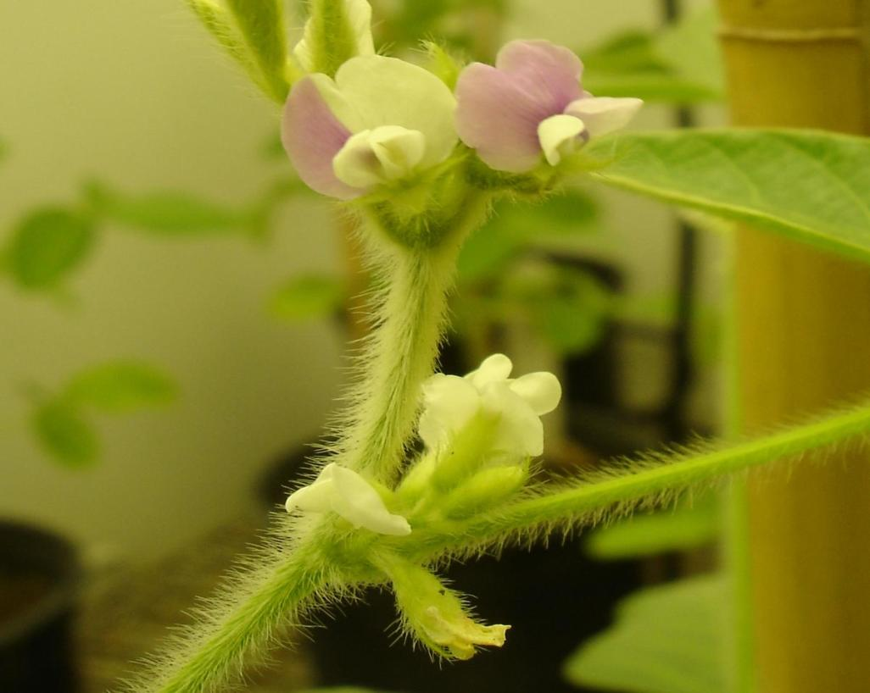

Slide 39
The W4 locus
+
p-Coumaroyl-CoA
3 x Malonyl-CoA
CHS
Chalcone
CHI
Naringenin
Flavanone 3-hydroxylase (Wp)
F3’H
F3’5’H
Dihydroquercetin
Dihydrokaempferol
Dihydromyricetin
(Dihydroflavonols)
Flavonol synthase
Flavonol synthase
Flavonol synthase (Wm)
Quercetin
Kaempferol
Myricetin
(Flavonols)
Dihydroflavonol-4-reductase (DFR) (W3,W4)
Dihydroflavonol-4-reductase (DFR) (W3)
Dihydroflavonol-4-reductase (DFR) (W3, W4)
Leucocyanidin
Leucopelargonidin
Leucodelphinidin
(Leucoflavonols)
Anthocyanidin synthase
3-glucosyl transferase
Anthocyanidin synthase
3-glucosyl transferase
Anthocyanidin synthase
3-glucosyl transferase (ANS)
Cyanidin-3-glucoside
Pelargonidin-3-glucoside
Delphinidin-3-glucoside
(Anthocyanins)
Xu et al. 2010
Notes:
39

Slide 40
A CACTA-type Transposable Element Tgm9 in the DFR2 Intron II causes loss of DFR2 function in Soybean.
TATA box
CTAAGGCGGTTATAAATAACCATCTTAGTAACTCGCTGGGTGGCATTTTT
ATG
TAA
ATG
TAA
Tgm9 (20,548 bp)
1
2
3
4
5
6
8
9
10
11
12
14
18
7
13
20
15
16
17
19
21
22
23
24
25
26
27
ORF1
(GmTNP2)
ORF2
(GmTNP1)
Truncated Tgm9
(1354 bp)
ATT
Identical
Xu et al. 2010
Notes:
40

Slide 41
The W4 locus
+
p-Coumaroyl-CoA
3 x Malonyl-CoA
CHS
Chalcone
CHI
Naringenin
Flavanone 3-hydroxylase (Wp)
F3’H
F3’5’H
Dihydroquercetin
Dihydrokaempferol
Dihydromyricetin
(Dihydroflavonols)
Flavonol synthase
Flavonol synthase
Flavonol synthase (Wm)
Quercetin
Kaempferol
Myricetin
(Flavonols)
Dihydroflavonol-4-reductase (DFR) (W3,W4)
Dihydroflavonol-4-reductase (DFR) (W3)
Dihydroflavonol-4-reductase (DFR) (W3, W4)
Leucocyanidin
Leucopelargonidin
Leucodelphinidin
(Leucoflavonols)
Anthocyanidin synthase
3-glucosyl transferase
Anthocyanidin synthase
3-glucosyl transferase
Anthocyanidin synthase
3-glucosyl transferase (ANS)
Cyanidin-3-glucoside
Pelargonidin-3-glucoside
Delphinidin-3-glucoside
(Anthocyanins)
Xu et al. 2010
Notes:
41

Slide 43
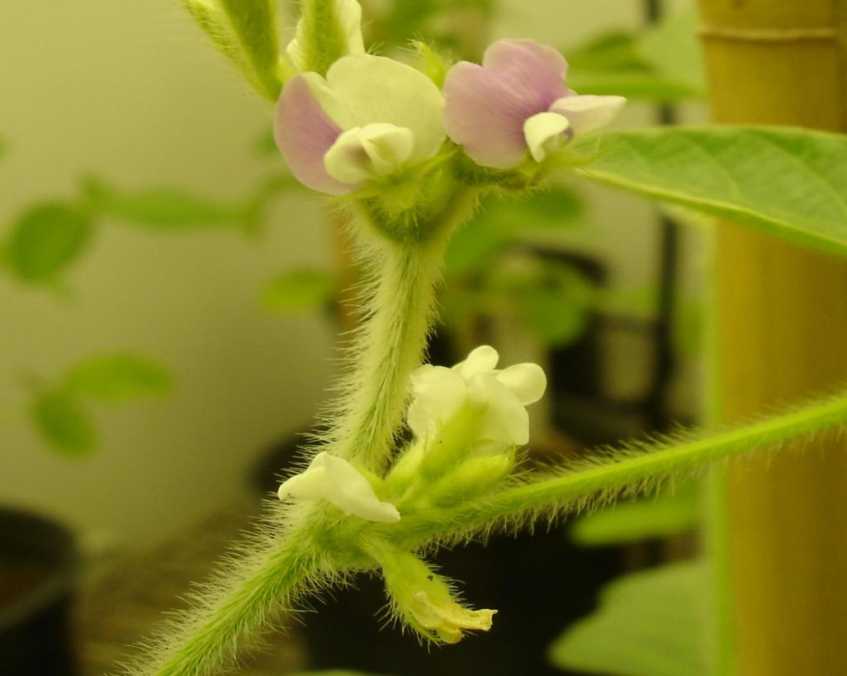

Slide 44
What have you learned today?
With new knowledge about genes available, the central dogma became irrelevant.
Despite the information flow from DNA to RNA and then RNA to protein is universal; there are many exceptions discovered in later years.
Gene does not work alone. A gene is a team player; work in a group. As you have seen, mutation in a single gene can have profound effect on phenotype.
Wrinkled seed shape and sweetness in sweet peas are the result of a mutation in a starch branching enzyme gene leading to reduced amylopectin and increased amylose as well as sucrose contents.
Variegated flowers in soybean is induced by excision of Tgm9 from the DFR2 gene, a member of the group of genes that control the anthocyanin biosynthetic pathway.

Slide 45
Plant Breeding Implications
Traits are governed by a large number of genes. Genes we target to breed in are usually regulatory genes that control the entire pathway.
Disease resistance (R) genes are a good example. R genes are single genes; they however need a large number of genes to manifest the resistance.
Two metabolic pathways shown here also show how structural genes are important in manifesting phenotypes.
Mutants are the keys to studying the phenotypes.
Metabolic markers are better predictors of phenotypes. Why not apply?
Metabolite panels are used to check our health!

Slide 46
Let’s talk about the things that you are not clear!

